Slide 1
Review 4
Jamie Zhang

Slide 2
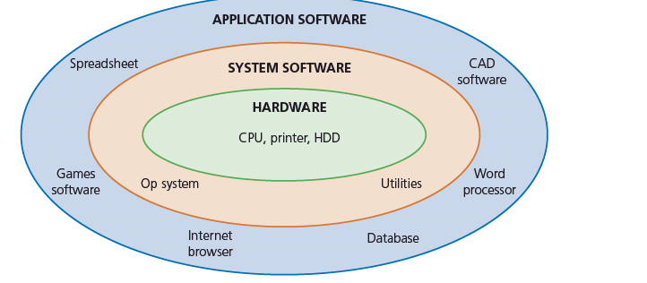
Software

Slide 3
Software
General features of system software
-set of programs to control and manage the operation of computer hardware
-provides a platform on which other software can run
-required to allow hardware and software to run without problems
-provides a human computer interface (HCI)
-controls the allocation and usage of hardware resources.
General features of application software
-used to perform various applications (apps) on a computer
-allows a user to perform specific tasks using the computer’s resources
-may be a single program (for example, NotePad) or a suite of programs (for example, Microsoft Office)
-user can execute the software as and when they require.

Slide 4
Utilities
Utility programs offered by most computer system software include:
- virus checkers
- defragmentation software
- disk contents analysis and repair
- file compression and file management
- back-up software
- security
- screensavers.

